Slide 1
Vietnam Marketing & Sales Planning
Loi Vu
Sales Manager

Slide 2
Agenda
Executive Summary
Market analysis
Segmentation
Competitive matrix
Strategy
Tactical
Financial Model
Team & Implementation
Measurement
Risk

Slide 3
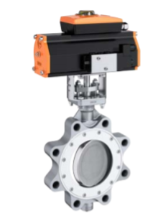
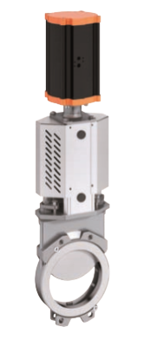
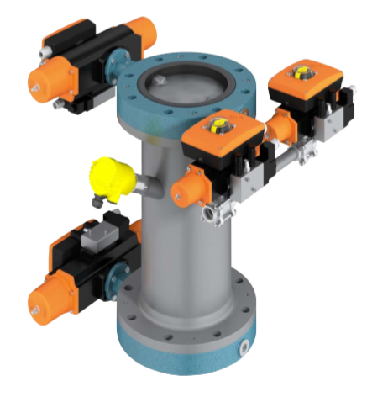
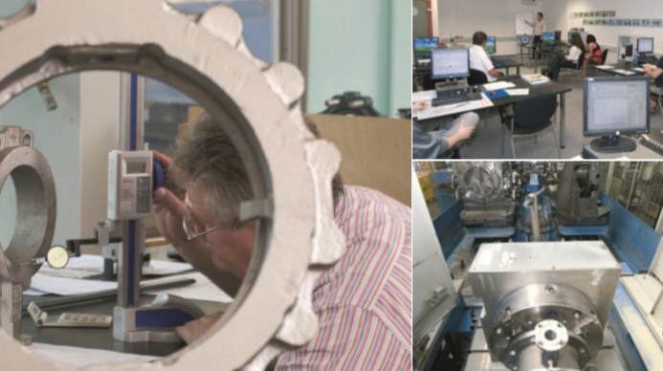
Executive Summary
Overview
EBRO ARMATUREN the world's leading manufacturers of industrial valves, actuators and automation technology
Excellent expertise combined with high-quality products makes us an internationally acknowledged partner of the machine and plant engineering sector.
We offer customized solutions for almost every individual application. By developing and producing our own actuators, we can guarantee an optimal matching with the valves.
Under the umbrella of the Bröer Group our product range is broadened by high-class knife gate valves produced by our Swedish subsidiary Stafsjö Valves AB, one of the leading suppliers in this sector.
Notes:
Water & Waste water transport or treatment of municipal or industrial wastewater, or during the production and treatment of drinking water =>butterfly and check valves as well as knife gate valves for the use with very dirty fluids
Energy power stations nuclear or fossil-fuelled, or when used in plants for renewable energy , boiler feed water, condensate, cooling water or coolants=>shut-off and control valves
Bulk Solids sensitive fluids like milk powder or tea leaves, high abrasive fluids like quartz sand or porcelain slurry => Impeller valves and inflatable liners for sensitive products, abrasion-resistant materials like the special coating of polyurethane for abrasive fluids and vibrating valve discs for the prevention of adhesion
FMCG the gentle handling of the subsidized products is a top priority, components have to meet this requirement by being designed in a way that they do not destroy the product and may not introduce contaminants into the duct system.=>Butterfly valves of the series "Inflas" are designed and equipped with a sealing system which is pressed to the disc after the closing operation. This way, the grinding or crushing of the feed-through products is effectively prevented.
Chemical Industry =>The PAS (Public available specification) 1085 specifies the delivery conditions for valves, regulating units and process control modules which are used in the chemical industry.
Pulp & Paper if it is steam, oil, chemicals or rejects, no matter if liquid or viscous, we are able to offer a valve solution for every application in the pulp and paper industry => Knife Gate-, Butterfly-, Ball- and Sector Valves equipped with tailored actuators and automation technology you will always find a solution to solve the tasks in your application.
Transport & Haulage the outlet of silo trucks, in the filter system of pools on cruise ships or in the ballast system of tankers- valves and actuators of Ebro are always first choice when quality and reliability are the selection criteria.
Mining From heavy duty slurry handling to high temperature corrosive applications EBRO has a range of purpose designed knifegate and butterfly valves to meet all needs. The EBRO butterfly valves have set the bench mark for reliable, safe operations in highly corrosive Hydrometallurgical circuits and acid handling

Slide 4
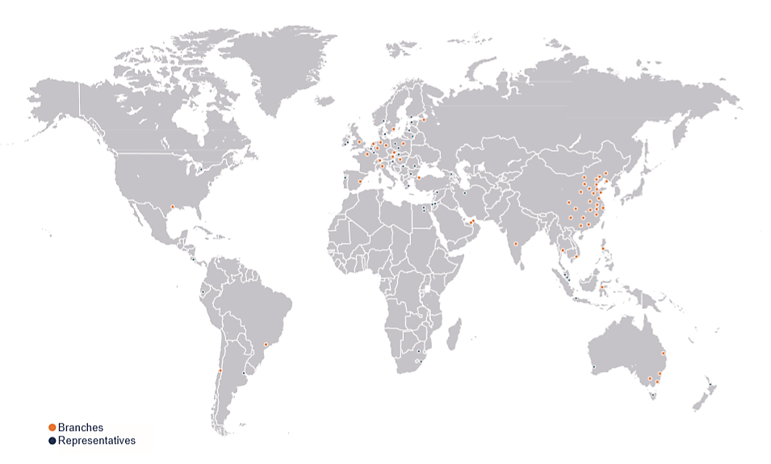
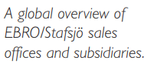
Executive Summary
Saigon_Vietnam
Ebro Thailand
Notes:
Water & Waste water transport or treatment of municipal or industrial wastewater, or during the production and treatment of drinking water =>butterfly and check valves as well as knife gate valves for the use with very dirty fluids
Energy power stations nuclear or fossil-fuelled, or when used in plants for renewable energy , boiler feed water, condensate, cooling water or coolants=>shut-off and control valves
Bulk Solids sensitive fluids like milk powder or tea leaves, high abrasive fluids like quartz sand or porcelain slurry => Impeller valves and inflatable liners for sensitive products, abrasion-resistant materials like the special coating of polyurethane for abrasive fluids and vibrating valve discs for the prevention of adhesion
FMCG the gentle handling of the subsidized products is a top priority, components have to meet this requirement by being designed in a way that they do not destroy the product and may not introduce contaminants into the duct system.=>Butterfly valves of the series "Inflas" are designed and equipped with a sealing system which is pressed to the disc after the closing operation. This way, the grinding or crushing of the feed-through products is effectively prevented.
Chemical Industry =>The PAS (Public available specification) 1085 specifies the delivery conditions for valves, regulating units and process control modules which are used in the chemical industry.
Pulp & Paper if it is steam, oil, chemicals or rejects, no matter if liquid or viscous, we are able to offer a valve solution for every application in the pulp and paper industry => Knife Gate-, Butterfly-, Ball- and Sector Valves equipped with tailored actuators and automation technology you will always find a solution to solve the tasks in your application.
Transport & Haulage the outlet of silo trucks, in the filter system of pools on cruise ships or in the ballast system of tankers- valves and actuators of Ebro are always first choice when quality and reliability are the selection criteria.
Mining From heavy duty slurry handling to high temperature corrosive applications EBRO has a range of purpose designed knifegate and butterfly valves to meet all needs. The EBRO butterfly valves have set the bench mark for reliable, safe operations in highly corrosive Hydrometallurgical circuits and acid handling

Slide 5
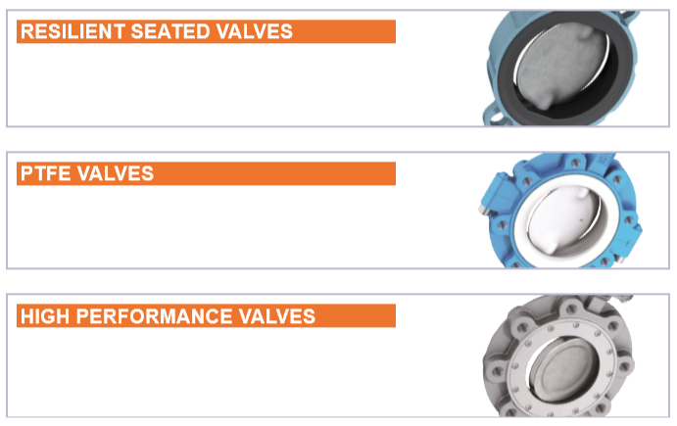
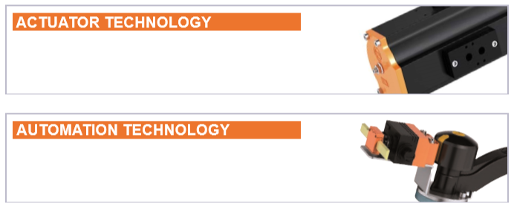
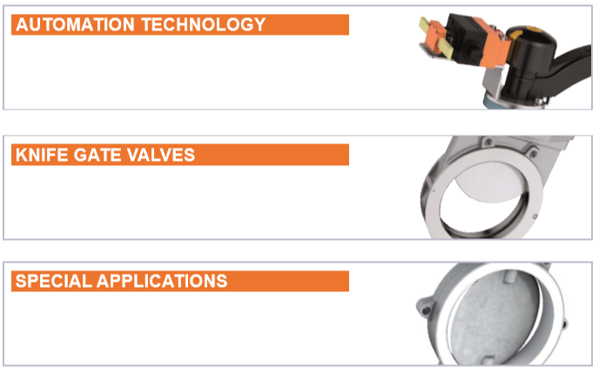
Executive Summary
The right valve for every application
Actuator & Automation technology
Notes:
Water & Waste water transport or treatment of municipal or industrial wastewater, or during the production and treatment of drinking water =>butterfly and check valves as well as knife gate valves for the use with very dirty fluids
Energy power stations nuclear or fossil-fuelled, or when used in plants for renewable energy , boiler feed water, condensate, cooling water or coolants=>shut-off and control valves
Bulk Solids sensitive fluids like milk powder or tea leaves, high abrasive fluids like quartz sand or porcelain slurry => Impeller valves and inflatable liners for sensitive products, abrasion-resistant materials like the special coating of polyurethane for abrasive fluids and vibrating valve discs for the prevention of adhesion
FMCG the gentle handling of the subsidized products is a top priority, components have to meet this requirement by being designed in a way that they do not destroy the product and may not introduce contaminants into the duct system.=>Butterfly valves of the series "Inflas" are designed and equipped with a sealing system which is pressed to the disc after the closing operation. This way, the grinding or crushing of the feed-through products is effectively prevented.
Chemical Industry =>The PAS (Public available specification) 1085 specifies the delivery conditions for valves, regulating units and process control modules which are used in the chemical industry.
Pulp & Paper if it is steam, oil, chemicals or rejects, no matter if liquid or viscous, we are able to offer a valve solution for every application in the pulp and paper industry => Knife Gate-, Butterfly-, Ball- and Sector Valves equipped with tailored actuators and automation technology you will always find a solution to solve the tasks in your application.
Transport & Haulage the outlet of silo trucks, in the filter system of pools on cruise ships or in the ballast system of tankers- valves and actuators of Ebro are always first choice when quality and reliability are the selection criteria.
Mining From heavy duty slurry handling to high temperature corrosive applications EBRO has a range of purpose designed knifegate and butterfly valves to meet all needs. The EBRO butterfly valves have set the bench mark for reliable, safe operations in highly corrosive Hydrometallurgical circuits and acid handling

Slide 6

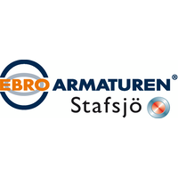
Positioning
One of the leading valve & actuator making know-how company
Highest quality resilient seated butterfly valves in the market today, Ebro Armaturen.
Ebro Armaturen has been holding over years a leading position versus its peers with regards to quality, technology and financial performance
Safety
Quality
Solution
Cost
Reliable
Reduce NPT

Slide 7
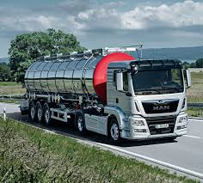

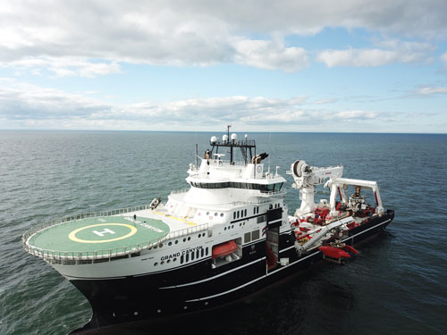
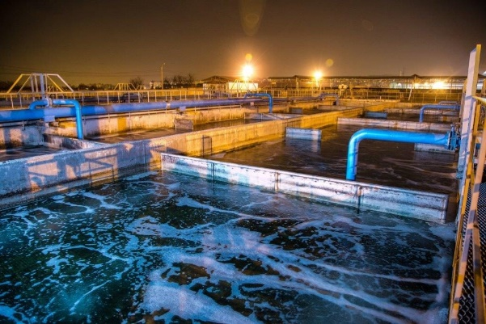
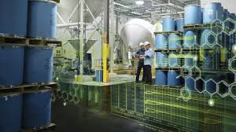


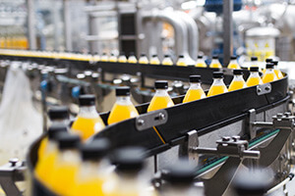

Market Analysis
Energy
Heating & Cooling, Biogas, Thermal power, geothermal, nuclear
Chemical
Petrochemical, highly corrosive, paint production , chlorine, chemical industry, O&G, Pharmaceuticals .etc
Ship Building
Transport/ Contain of Hazardous Goods, Silo, Shipbuilding
Water/Wastewater
Industrial waste water, Municipal Wastewater, Offshore, Pharmaceutical Grade water, Hot & Steam System, Desalination of sea water
Steel & Cement
(bulk solids, blasting plant, Silos & Container , Material handling, steel industry, Solids-containing media, dust removal)
Pulp & Paper
(Paper , cardboard factory)
E&C
FMCG
(F&B, Sugar, Agricultural, Grain, Breweries,
Filling System)
Notes:
Water & Waste water transport or treatment of municipal or industrial wastewater, or during the production and treatment of drinking water =>butterfly and check valves as well as knife gate valves for the use with very dirty fluids
Energy power stations nuclear or fossil-fuelled, or when used in plants for renewable energy , boiler feed water, condensate, cooling water or coolants=>shut-off and control valves
Bulk Solids sensitive fluids like milk powder or tea leaves, high abrasive fluids like quartz sand or porcelain slurry => Impeller valves and inflatable liners for sensitive products, abrasion-resistant materials like the special coating of polyurethane for abrasive fluids and vibrating valve discs for the prevention of adhesion
FMCG the gentle handling of the subsidized products is a top priority, components have to meet this requirement by being designed in a way that they do not destroy the product and may not introduce contaminants into the duct system.=>Butterfly valves of the series "Inflas" are designed and equipped with a sealing system which is pressed to the disc after the closing operation. This way, the grinding or crushing of the feed-through products is effectively prevented.
Chemical Industry =>The PAS (Public available specification) 1085 specifies the delivery conditions for valves, regulating units and process control modules which are used in the chemical industry.
Pulp & Paper if it is steam, oil, chemicals or rejects, no matter if liquid or viscous, we are able to offer a valve solution for every application in the pulp and paper industry => Knife Gate-, Butterfly-, Ball- and Sector Valves equipped with tailored actuators and automation technology you will always find a solution to solve the tasks in your application.
Transport & Haulage the outlet of silo trucks, in the filter system of pools on cruise ships or in the ballast system of tankers- valves and actuators of Ebro are always first choice when quality and reliability are the selection criteria.
Mining From heavy duty slurry handling to high temperature corrosive applications EBRO has a range of purpose designed knifegate and butterfly valves to meet all needs. The EBRO butterfly valves have set the bench mark for reliable, safe operations in highly corrosive Hydrometallurgical circuits and acid handling

Slide 8
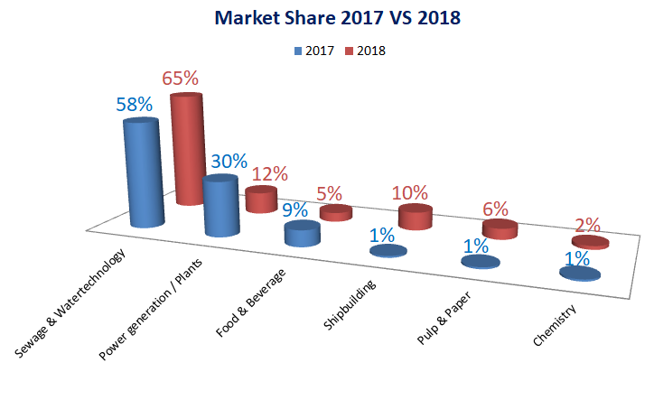
Market Share
Notes:
Water & Waste water transport or treatment of municipal or industrial wastewater, or during the production and treatment of drinking water =>butterfly and check valves as well as knife gate valves for the use with very dirty fluids
Energy power stations nuclear or fossil-fuelled, or when used in plants for renewable energy , boiler feed water, condensate, cooling water or coolants=>shut-off and control valves
Bulk Solids sensitive fluids like milk powder or tea leaves, high abrasive fluids like quartz sand or porcelain slurry => Impeller valves and inflatable liners for sensitive products, abrasion-resistant materials like the special coating of polyurethane for abrasive fluids and vibrating valve discs for the prevention of adhesion
FMCG the gentle handling of the subsidized products is a top priority, components have to meet this requirement by being designed in a way that they do not destroy the product and may not introduce contaminants into the duct system.=>Butterfly valves of the series "Inflas" are designed and equipped with a sealing system which is pressed to the disc after the closing operation. This way, the grinding or crushing of the feed-through products is effectively prevented.
Chemical Industry =>The PAS (Public available specification) 1085 specifies the delivery conditions for valves, regulating units and process control modules which are used in the chemical industry.
Pulp & Paper if it is steam, oil, chemicals or rejects, no matter if liquid or viscous, we are able to offer a valve solution for every application in the pulp and paper industry => Knife Gate-, Butterfly-, Ball- and Sector Valves equipped with tailored actuators and automation technology you will always find a solution to solve the tasks in your application.
Transport & Haulage the outlet of silo trucks, in the filter system of pools on cruise ships or in the ballast system of tankers- valves and actuators of Ebro are always first choice when quality and reliability are the selection criteria.
Mining From heavy duty slurry handling to high temperature corrosive applications EBRO has a range of purpose designed knifegate and butterfly valves to meet all needs. The EBRO butterfly valves have set the bench mark for reliable, safe operations in highly corrosive Hydrometallurgical circuits and acid handling

Slide 9
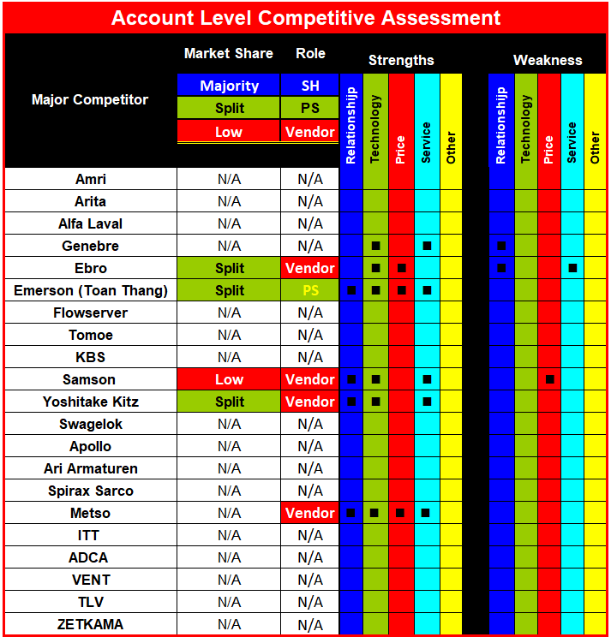
Competitive Matrix
Avoid strong one

Slide 10
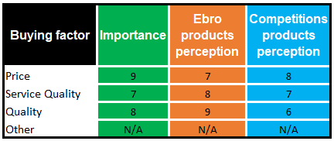
Buy Factor
Understand what’s important to them & perception about Ebro products VS to competitors
Perception ratings Ebro products VS competitions
Buying process

Slide 11
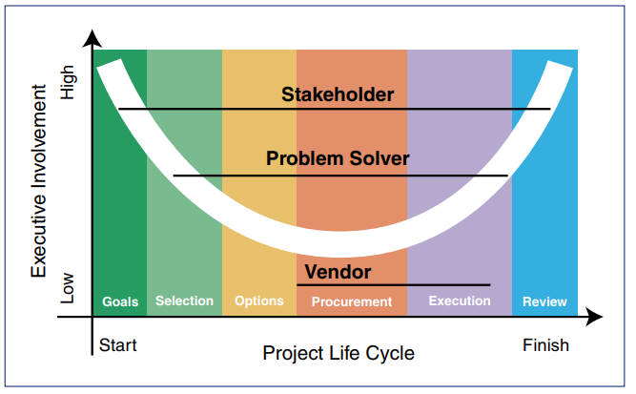
Strategy To be number one
Trusted Advisor, If the customer considers us a trusted advisor, we are viewed as a stakeholder. At this level, the customer believes Ebro is interested in optimizing the performance of their process. We have demonstrated our concern that they achieve their goals and objectives. When viewed as a trusted advisor, we will be involved in all five stages of the customer’s project life cycle.
Problem Solver, If the customer considers us a problem solver, Ebro is viewed as technical specialists. This perception can apply to specific products or services, or can apply only to a specific situation, such as our expertise in the valve industrial development.
Vendor, The account considers as a vendor if the only time Ebro becomes involved in a project is when we receive a tender to bid during the procurement process. If we win the contract, we participate in the execution. In this role the vendor does not have contact at the executive level. With such limited exposure to the customer’s project life cycle, we cannot have much influence.

Slide 12
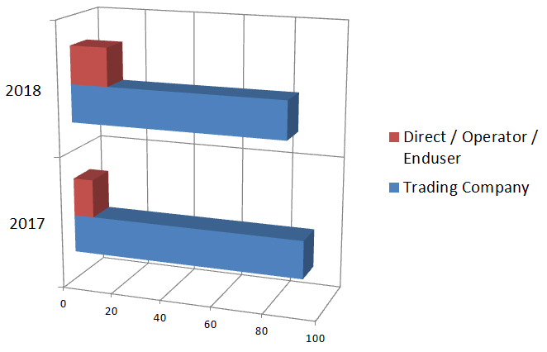
Strategy
Maintain revenue with existing clients through out 2015-2019 with MRO & extended plan.
15%
85%
Pulp & paper : increasing the turnover of MV and WB series
Shipbuilding : increasing the turnover of Z series (made in Thailand) with BV certificate
Maintaining the first priority market segments (water technology, plant engineering & construction).
Expanding the second priority market segments (food & beverage, MRO) :
F & B : increasing the turnover of EB series
MRO : increasing the turnover of Z series
Developing the third and fourth priority market segments
Pulp & paper : increasing the turnover of MV and WB series
Shipbuilding : increasing the turnover of Z series (made in Thailand) with BV certificate
8%
Targeting into Petrochemical and Refinery
Increase serviceable market ig . Chemical, FMCG, Pulp&Paper & Energy
Projects tender by cooperating with FEED, EPCI/ EPC/ Sub-contractor/ Piping enterprises
92%

Slide 13
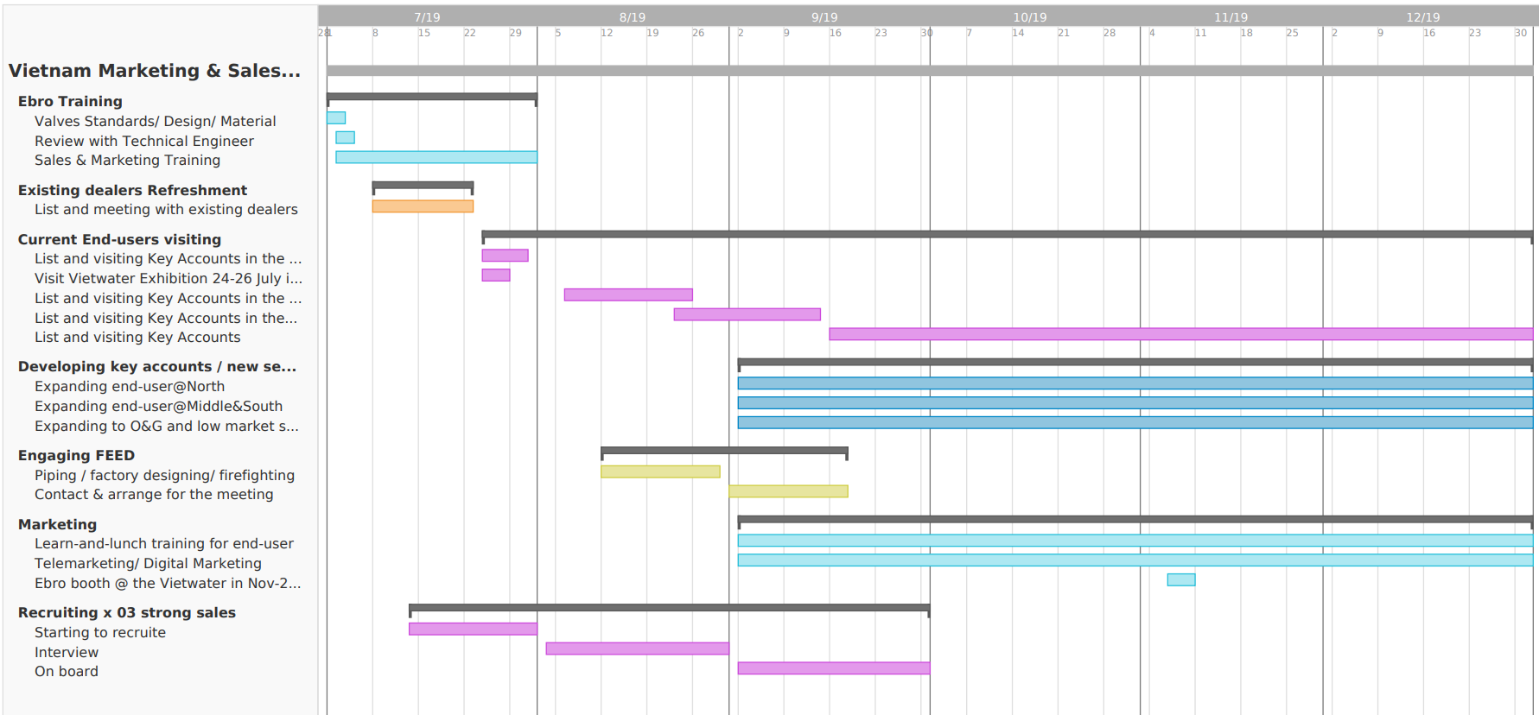
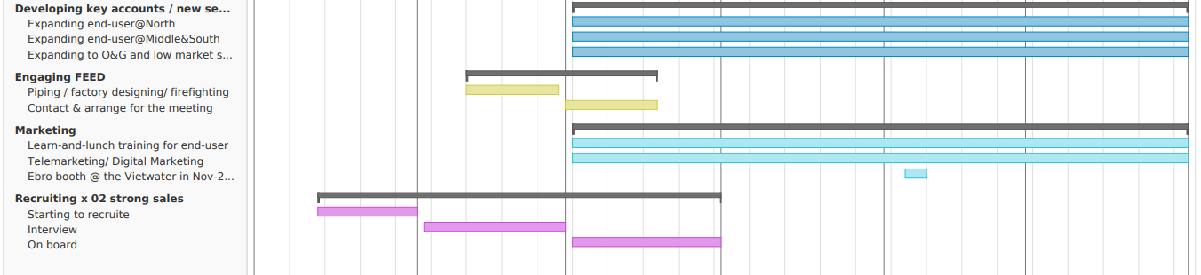
Strategy Execution
Jul-19
Aug-19
Sep-19
Oct-19
Nov-19
Dec-19
July 2019
September 2019
Maintain turnover
from current dealers
Increase end-users,
more distributors
Get ready sales team to expand market as planning
Jan | Feb | Mar | Apr | May | Jun | Jul | Aug | Sept | Oct | Nov | Dec
December 2019
Year end review

Slide 14
Tactical
Personal Selling, Regularly Scheduled Informational Events
- Lunch and learns: Ebro-sponsored lunches with guest speakers discussing latest developments in issues that are relevant to a target audience, such as Industrial Mobility, BI (Manufacture Intelligence), Smart Factory. Ally with pump, piping, automation companies for the events.
- Participation at professional society conferences and meetings: Ebro speakers presenting technical papers on the latest technology developments and applications. Ebro booth in exhibition hall.
- Annual VIP seminars: Courtesy meetings between upper management teams demonstrating solutions to their business issues.
- Industry-sponsored training sessions: Ebro-sponsored training courses for technologies used within the Market.
Direct Marketing and Sales Tools
- 4.0 Industrial Review distribution: Complimentary copies of 4.0 Industrial Review to selected key customers in key accounts.
Advertising
National and international advertising campaigns: Advertising programs in major trade journals and business magazines.
Google Ad, Twitter, Facebook, LinkedIn
Public Relations
- Ebro in Education and Development: A Ebro-sponsored program community development programs— Science Center, University for example to support valves/ actuators for students learning.
Personal Selling, Regularly Scheduled Informational Events
- Lunch and learns: Ebro-sponsored lunches with guest speakers discussing latest developments in issues that are relevant to a target audience, such as Industrial Mobility, BI (Manufacture Intelligence), Smart Factory. Ally with pump, piping, automation companies for the events.
Annual VIP seminars: Courtesy meetings between upper management teams demonstrating solutions to their business issues.
Industry-sponsored training sessions: Ebro-sponsored training courses for technologies used within the Market.
- Award of Thailand manufacture tour for key accounts if met a certain PO
- Award of Europe product center tour for key accounts if met a certain PO

Slide 15
Tactical
Personal Selling, Regularly Scheduled Informational Events
- Lunch and learns: Ebro-sponsored lunches with guest speakers discussing latest developments in issues that are relevant to a target audience, such as Industrial Mobility, BI (Manufacture Intelligence), Smart Factory. Ally with pump, piping, automation companies for the events.
- Participation at professional society conferences and meetings: Ebro speakers presenting technical papers on the latest technology developments and applications. Ebro booth in exhibition hall.
- Annual VIP seminars: Courtesy meetings between upper management teams demonstrating solutions to their business issues.
- Industry-sponsored training sessions: Ebro-sponsored training courses for technologies used within the Market.
Direct Marketing and Sales Tools
- 4.0 Industrial Review distribution: Complimentary copies of 4.0 Industrial Review to selected key customers in key accounts.
Advertising
National and international advertising campaigns: Advertising programs in major trade journals and business magazines.
Google Ad, Twitter, Facebook, LinkedIn
Public Relations
- Ebro in Education and Development: A Ebro-sponsored program community development programs— Science Center, University for example to support valves/ actuators for students learning.
Personal Selling, Regularly Scheduled Informational Events
Participation at professional society conferences and meetings: Ebro speakers presenting technical papers on the latest technology developments and applications. Ebro booth in exhibition hall.
Expand as much as distributors.
Find pump, piping, water, firefighting.etc. companies for cross-sales

Slide 16
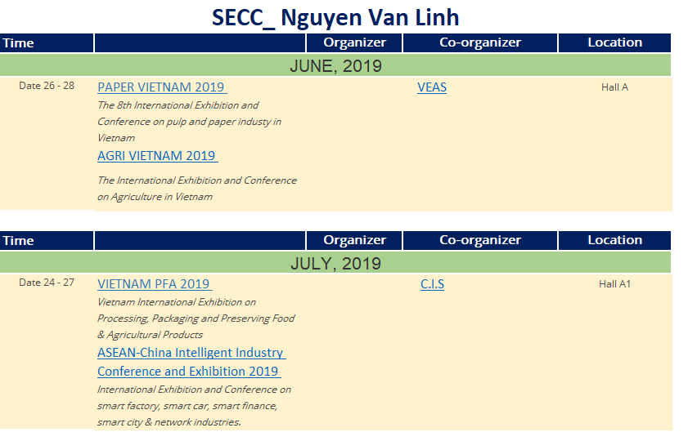
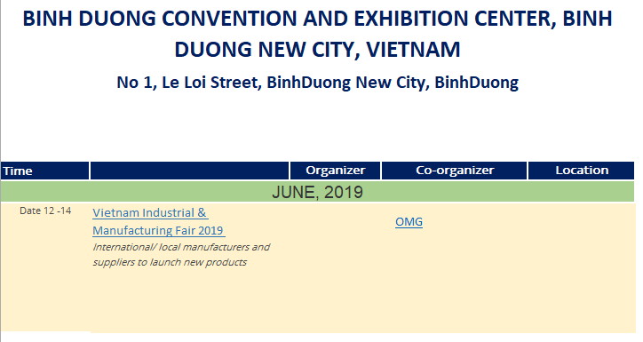
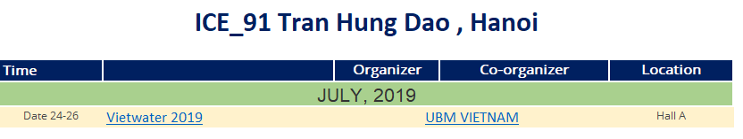
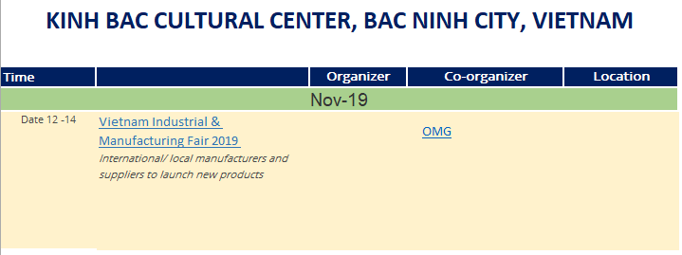
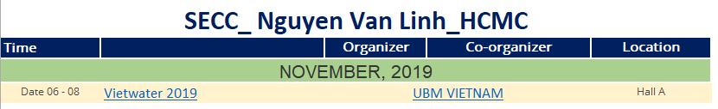
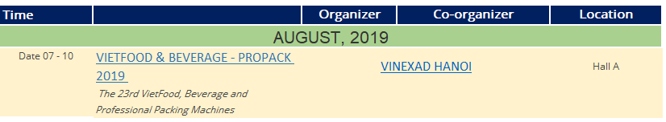
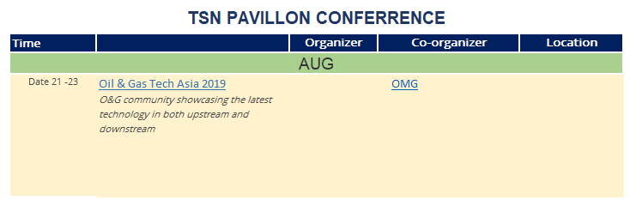
Tactical
Personal Selling, Regularly Scheduled Informational Events
- Lunch and learns: Ebro-sponsored lunches with guest speakers discussing latest developments in issues that are relevant to a target audience, such as Industrial Mobility, BI (Manufacture Intelligence), Smart Factory. Ally with pump, piping, automation companies for the events.
- Participation at professional society conferences and meetings: Ebro speakers presenting technical papers on the latest technology developments and applications. Ebro booth in exhibition hall.
- Annual VIP seminars: Courtesy meetings between upper management teams demonstrating solutions to their business issues.
- Industry-sponsored training sessions: Ebro-sponsored training courses for technologies used within the Market.
Direct Marketing and Sales Tools
- 4.0 Industrial Review distribution: Complimentary copies of 4.0 Industrial Review to selected key customers in key accounts.
Advertising
National and international advertising campaigns: Advertising programs in major trade journals and business magazines.
Google Ad, Twitter, Facebook, LinkedIn
Public Relations
- Ebro in Education and Development: A Ebro-sponsored program community development programs— Science Center, University for example to support valves/ actuators for students learning.
Vietwater exhibition in July & November 2019
-Mandatory to have Ebro booth for at least 01 of this event

Slide 17
Tactical
Personal Selling, Regularly Scheduled Informational Events
- Lunch and learns: Ebro-sponsored lunches with guest speakers discussing latest developments in issues that are relevant to a target audience, such as Industrial Mobility, BI (Manufacture Intelligence), Smart Factory. Ally with pump, piping, automation companies for the events.
- Participation at professional society conferences and meetings: Ebro speakers presenting technical papers on the latest technology developments and applications. Ebro booth in exhibition hall.
- Annual VIP seminars: Courtesy meetings between upper management teams demonstrating solutions to their business issues.
- Industry-sponsored training sessions: Ebro-sponsored training courses for technologies used within the Market.
Direct Marketing and Sales Tools
- 4.0 Industrial Review distribution: Complimentary copies of 4.0 Industrial Review to selected key customers in key accounts.
Advertising
National and international advertising campaigns: Advertising programs in major trade journals and business magazines.
Google Ad, Twitter, Facebook, LinkedIn
Public Relations
- Ebro in Education and Development: A Ebro-sponsored program community development programs— Science Center, University for example to support valves/ actuators for students learning.
Direct Marketing and Sales Tools
- 4.0 Industrial Review distribution: Complimentary copies of 4.0 Industrial Review to selected key accounts.
Advertising
National and international advertising campaigns: Advertising programs in major trade journals and business magazines/ email campaigns
Google Ad Word , Twitter, Facebook, LinkedIn
Public Relations
- Ebro in Education and Development: A Ebro-sponsored program community development programs— Science Center, University for example to support valves/ actuators for students learning.

Slide 18

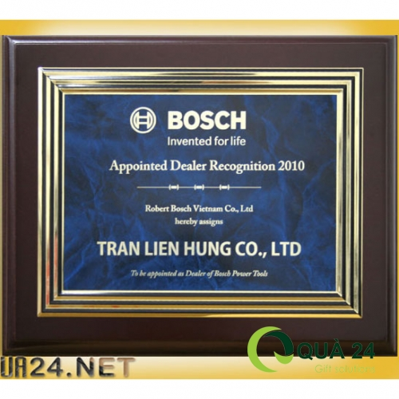

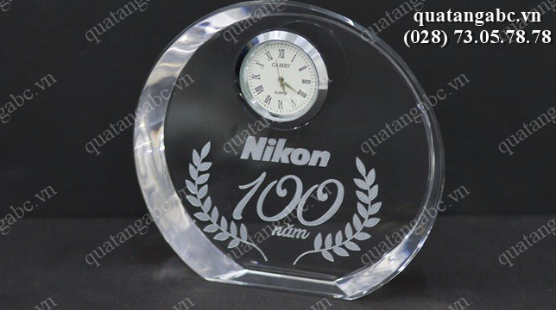
Tactical
Personal Selling, Regularly Scheduled Informational Events
- Lunch and learns: Ebro-sponsored lunches with guest speakers discussing latest developments in issues that are relevant to a target audience, such as Industrial Mobility, BI (Manufacture Intelligence), Smart Factory. Ally with pump, piping, automation companies for the events.
- Participation at professional society conferences and meetings: Ebro speakers presenting technical papers on the latest technology developments and applications. Ebro booth in exhibition hall.
- Annual VIP seminars: Courtesy meetings between upper management teams demonstrating solutions to their business issues.
- Industry-sponsored training sessions: Ebro-sponsored training courses for technologies used within the Market.
Direct Marketing and Sales Tools
- 4.0 Industrial Review distribution: Complimentary copies of 4.0 Industrial Review to selected key customers in key accounts.
Advertising
National and international advertising campaigns: Advertising programs in major trade journals and business magazines.
Google Ad, Twitter, Facebook, LinkedIn
Public Relations
- Ebro in Education and Development: A Ebro-sponsored program community development programs— Science Center, University for example to support valves/ actuators for students learning.
Appointed Distributors / Dealers Recognition
- Held Distributors/ Dealer award conference meeting and announcing best Distributors/ Dealer in September 2019
- Award of Thailand manufacture tour if meet a certain target
- Award of Europe product center tour if meet a certain target

Slide 19
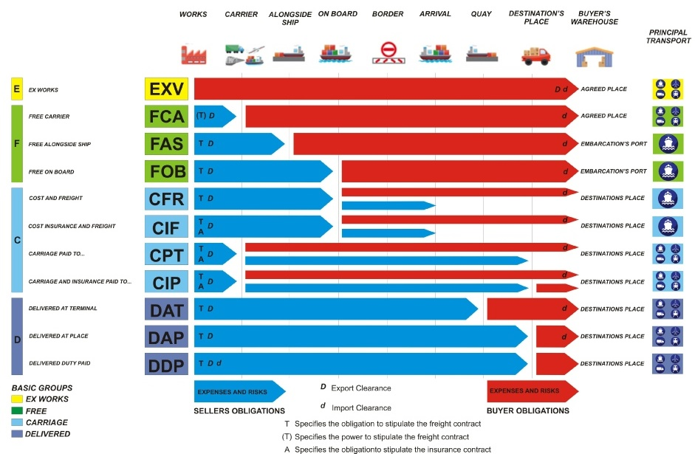
Logistic / Lead time
Personal Selling, Regularly Scheduled Informational Events
- Lunch and learns: Ebro-sponsored lunches with guest speakers discussing latest developments in issues that are relevant to a target audience, such as Industrial Mobility, BI (Manufacture Intelligence), Smart Factory. Ally with pump, piping, automation companies for the events.
- Participation at professional society conferences and meetings: Ebro speakers presenting technical papers on the latest technology developments and applications. Ebro booth in exhibition hall.
- Annual VIP seminars: Courtesy meetings between upper management teams demonstrating solutions to their business issues.
- Industry-sponsored training sessions: Ebro-sponsored training courses for technologies used within the Market.
Direct Marketing and Sales Tools
- 4.0 Industrial Review distribution: Complimentary copies of 4.0 Industrial Review to selected key customers in key accounts.
Advertising
National and international advertising campaigns: Advertising programs in major trade journals and business magazines.
Google Ad, Twitter, Facebook, LinkedIn
Public Relations
- Ebro in Education and Development: A Ebro-sponsored program community development programs— Science Center, University for example to support valves/ actuators for students learning.

Slide 20
Team
Marcus Schneider
International Sales Director
Chaichat Charikanonda
Managing Director
Loi Vu
Sales Manager
Ha Dang
Water&
Wastewater
Sales 1
Chemical/ Energy/ Marine/ Water&Wastewater
Sales 2
Pulp Paper/FMCG/
Bulk Solid
Existing Dealers
Distributor 1
Dealer 1/ Affiliate 1
Distributor
X-Sales 1
Distributor 2
Dealer 2/ Affiliate 2
Distributor
X-Sales 2

Slide 21
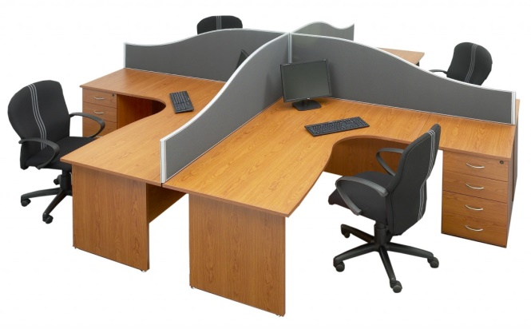

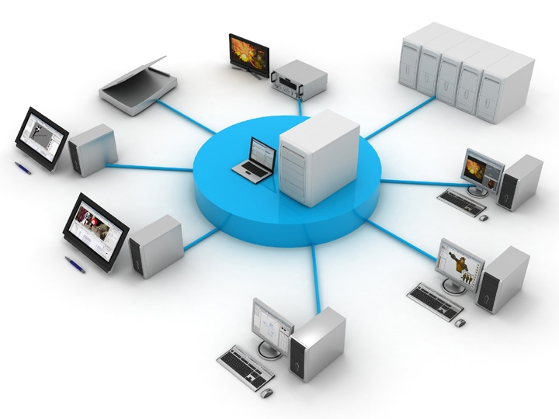
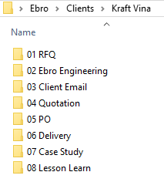
Team
Personal Selling, Regularly Scheduled Informational Events
- Lunch and learns: Ebro-sponsored lunches with guest speakers discussing latest developments in issues that are relevant to a target audience, such as Industrial Mobility, BI (Manufacture Intelligence), Smart Factory. Ally with pump, piping, automation companies for the events.
- Participation at professional society conferences and meetings: Ebro speakers presenting technical papers on the latest technology developments and applications. Ebro booth in exhibition hall.
- Annual VIP seminars: Courtesy meetings between upper management teams demonstrating solutions to their business issues.
- Industry-sponsored training sessions: Ebro-sponsored training courses for technologies used within the Market.
Direct Marketing and Sales Tools
- 4.0 Industrial Review distribution: Complimentary copies of 4.0 Industrial Review to selected key customers in key accounts.
Advertising
National and international advertising campaigns: Advertising programs in major trade journals and business magazines.
Google Ad, Twitter, Facebook, LinkedIn
Public Relations
- Ebro in Education and Development: A Ebro-sponsored program community development programs— Science Center, University for example to support valves/ actuators for students learning.
Weekly meeting EBVN - EBTH
Working folder arrangement

Slide 22
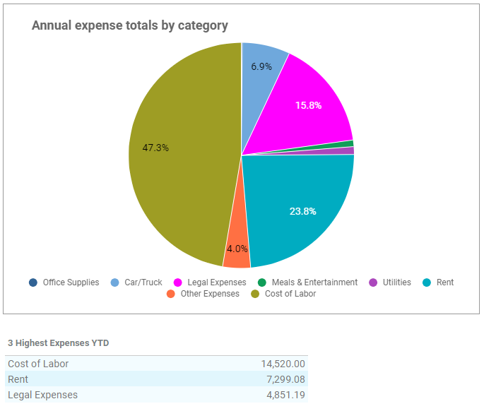
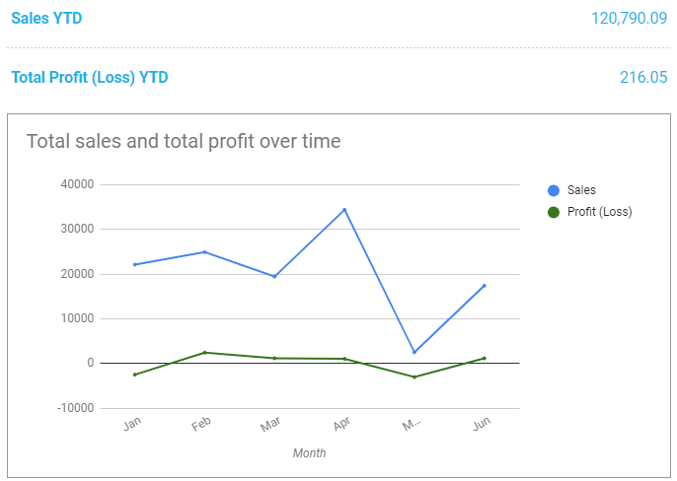

Financial Statement Jan-Jun_2019
Personal Selling, Regularly Scheduled Informational Events
- Lunch and learns: Ebro-sponsored lunches with guest speakers discussing latest developments in issues that are relevant to a target audience, such as Industrial Mobility, BI (Manufacture Intelligence), Smart Factory. Ally with pump, piping, automation companies for the events.
- Participation at professional society conferences and meetings: Ebro speakers presenting technical papers on the latest technology developments and applications. Ebro booth in exhibition hall.
- Annual VIP seminars: Courtesy meetings between upper management teams demonstrating solutions to their business issues.
- Industry-sponsored training sessions: Ebro-sponsored training courses for technologies used within the Market.
Direct Marketing and Sales Tools
- 4.0 Industrial Review distribution: Complimentary copies of 4.0 Industrial Review to selected key customers in key accounts.
Advertising
National and international advertising campaigns: Advertising programs in major trade journals and business magazines.
Google Ad, Twitter, Facebook, LinkedIn
Public Relations
- Ebro in Education and Development: A Ebro-sponsored program community development programs— Science Center, University for example to support valves/ actuators for students learning.
120,709.09
216.05
Most likely case
Worst case
47.3%
23.8%
15.8%

Slide 23
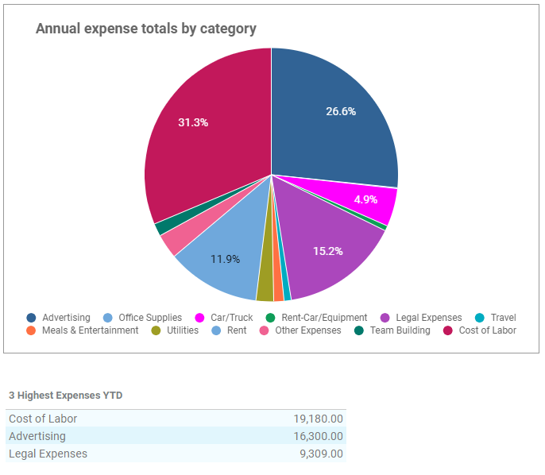
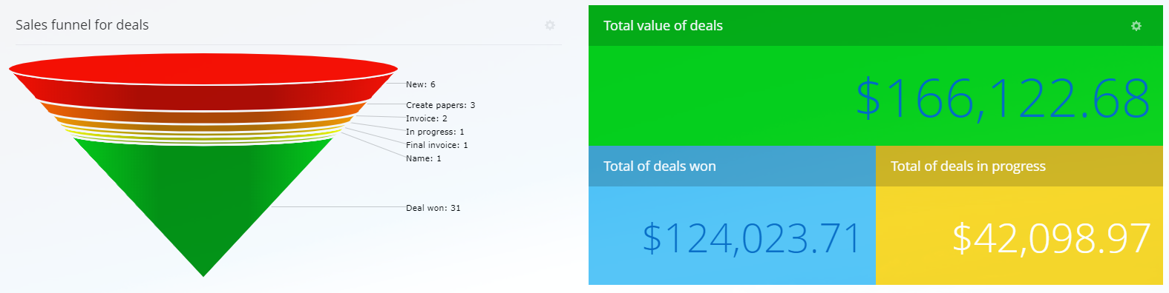
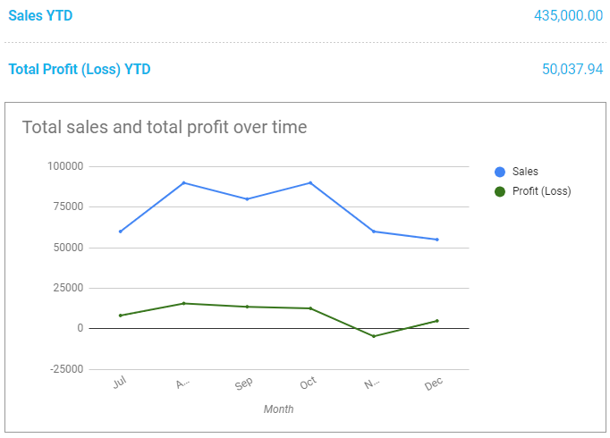
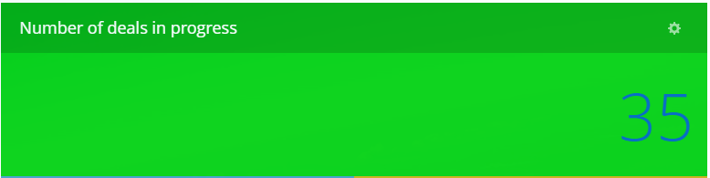


Financial Statement Jun-Dec_2019
Personal Selling, Regularly Scheduled Informational Events
- Lunch and learns: Ebro-sponsored lunches with guest speakers discussing latest developments in issues that are relevant to a target audience, such as Industrial Mobility, BI (Manufacture Intelligence), Smart Factory. Ally with pump, piping, automation companies for the events.
- Participation at professional society conferences and meetings: Ebro speakers presenting technical papers on the latest technology developments and applications. Ebro booth in exhibition hall.
- Annual VIP seminars: Courtesy meetings between upper management teams demonstrating solutions to their business issues.
- Industry-sponsored training sessions: Ebro-sponsored training courses for technologies used within the Market.
Direct Marketing and Sales Tools
- 4.0 Industrial Review distribution: Complimentary copies of 4.0 Industrial Review to selected key customers in key accounts.
Advertising
National and international advertising campaigns: Advertising programs in major trade journals and business magazines.
Google Ad, Twitter, Facebook, LinkedIn
Public Relations
- Ebro in Education and Development: A Ebro-sponsored program community development programs— Science Center, University for example to support valves/ actuators for students learning.
435,000.00
50,037.94
Most likely case
Worst case
41.3%
31.3%
13.8%
26.6%
11.6%
15.2%

Slide 24
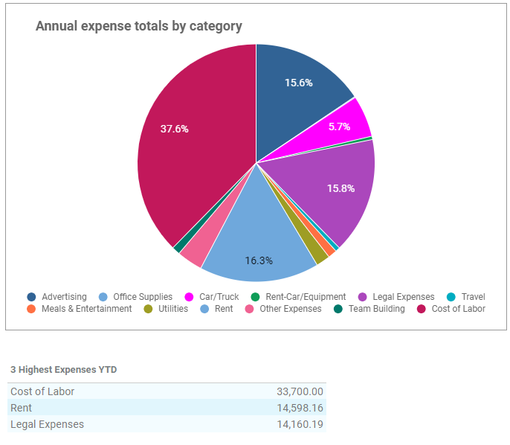
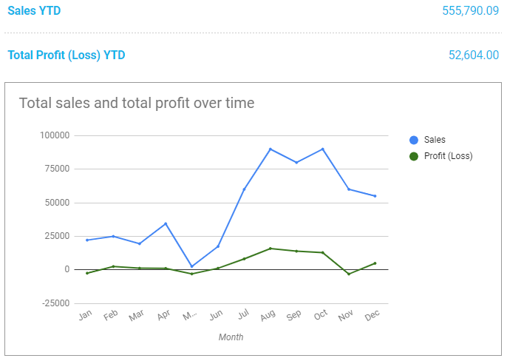
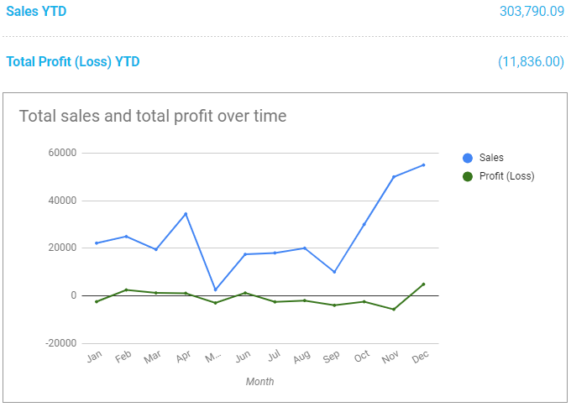
Financial Statement Jan-Dec_2019
Personal Selling, Regularly Scheduled Informational Events
- Lunch and learns: Ebro-sponsored lunches with guest speakers discussing latest developments in issues that are relevant to a target audience, such as Industrial Mobility, BI (Manufacture Intelligence), Smart Factory. Ally with pump, piping, automation companies for the events.
- Participation at professional society conferences and meetings: Ebro speakers presenting technical papers on the latest technology developments and applications. Ebro booth in exhibition hall.
- Annual VIP seminars: Courtesy meetings between upper management teams demonstrating solutions to their business issues.
- Industry-sponsored training sessions: Ebro-sponsored training courses for technologies used within the Market.
Direct Marketing and Sales Tools
- 4.0 Industrial Review distribution: Complimentary copies of 4.0 Industrial Review to selected key customers in key accounts.
Advertising
National and international advertising campaigns: Advertising programs in major trade journals and business magazines.
Google Ad, Twitter, Facebook, LinkedIn
Public Relations
- Ebro in Education and Development: A Ebro-sponsored program community development programs— Science Center, University for example to support valves/ actuators for students learning.
555,790.09
52,604.00
Most likely case
303,790.09
(11,836.00)
Worst case
37.6%
16.3%
15.8%
26.6%
15.2%

Slide 25
Objective
Maintain high percentage of market share 58% of water/wastewater
Increase low percentage market share of the from 5% to 10-20%
10-20 new end-user
Sales revenue from USD $700K up to USD $1,100K in 2020
Maintain high percentage of market share 65% of water/wastewater
Increase market share of Power generation, F&B and Shipbuilding

Slide 26
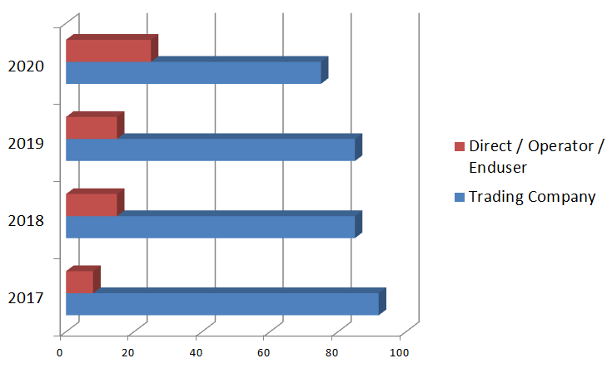
Objective
Increase 10-20 new end-users
25%
75%
15%
85%
15%
85%
8%
92%

Slide 27
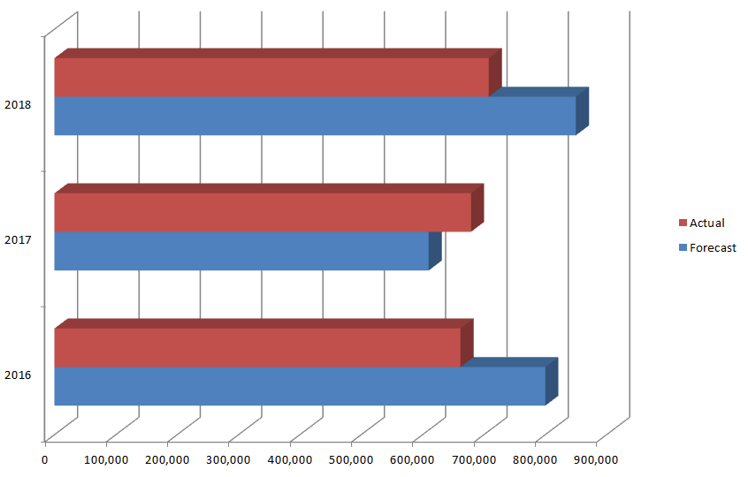
Objective
Sales turnover from USD $700K up to:
USD $1,000 - 1,100K in 2020 => Best case
USD $900 - 1,000K in 2020 => Most likely case
USD $500 - 7,00K in 2020
=> Worse case
-17%
708K
850K
11%
678K
609K
-17%
661K
800K

Slide 28
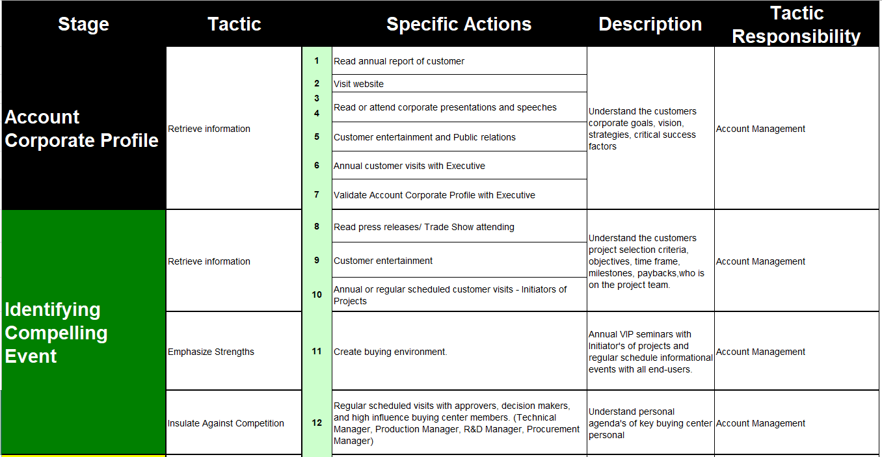
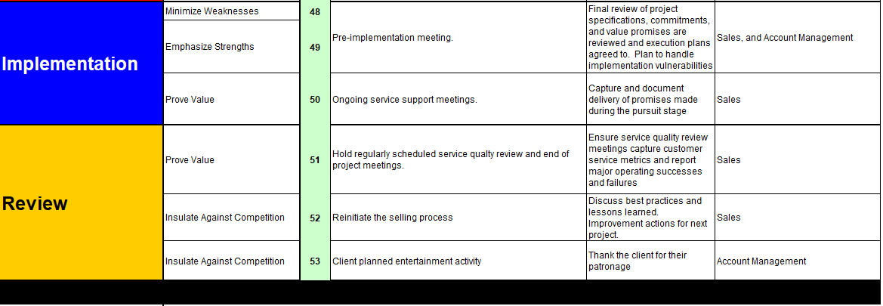
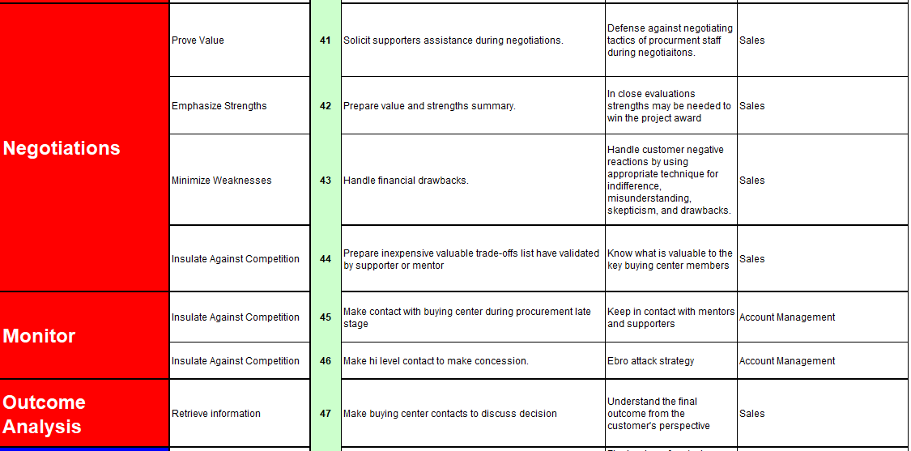
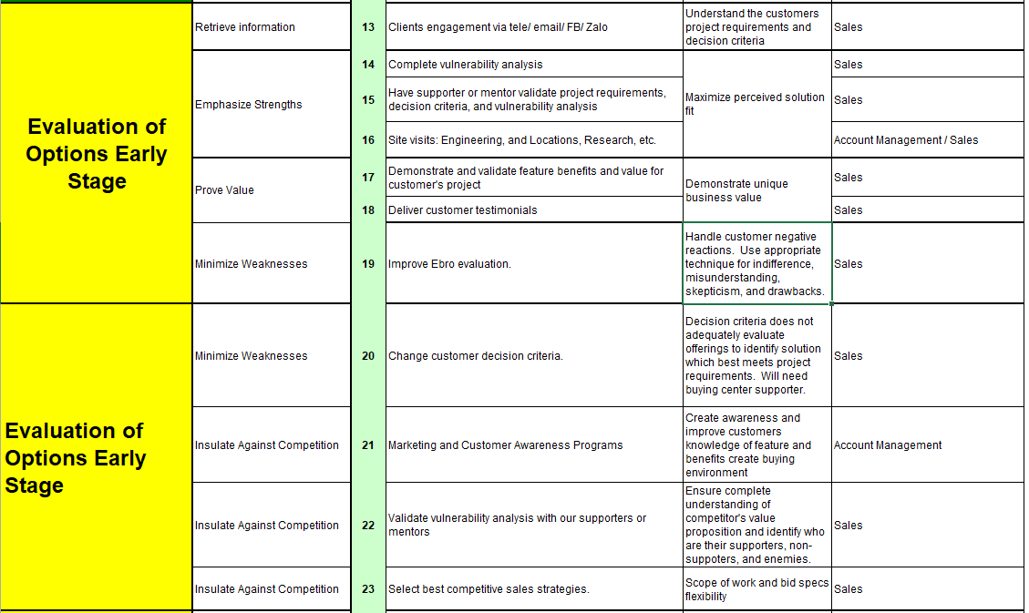

Implementation

Slide 29






Risk

Slide 30
Thank You

Slide 31
Team
Marcus Schneider
International Sales Director
Chaichat Charikanonda
Managing Director
Loi Vu
Sales Manager
Sales 1
Sales 2
Sales 3
Ha Dang
Chemical/ Energy/ E&C
Ship Build/ Water & Wastewater
Pulp Paper/FMCG/ Steel-Cement
Distr. 1
Dler. 1
X-Sls. 1
Distr. 1
Dler. 1
X-Sls. 1
Distr. 1
Dler. 1
X-Sls. 1
Existing Dealers

